Slide 1
Knowledge and Data Integration: Food and Accommodation
Byambakhishig Ganbold
Mithat Sinan Ergen

Slide 2

Outline
Project purpose
Scenario and Personas
Sources
Inception phase
Informal Model
Formal Model
Evaluation
Data Integration
Queries

Slide 3

Project Purpose
Provide users with information regarding food and accommodation in the Trentino region
Users will be able to plan their vacations according to this information
The accommodation information includes hotels, apartments, private rooms and camping with detailed information about price, facilities offered, number of stars, type of rooms in the Trentino region.
The food information includes restaurants, bars, pizzerias, ice-cream shops and their detailed information such as phone number, email and website.

Slide 4

Scenarıo and personas
8 personas of different ages and background
Various scenarios such as:
sport festival
summer vacation
winter vacation
visit in the weekend.

Slide 5





sources
Data Sources:
Open Data Trentino: open data source providing data for the Trentino region
Inside Airbnb: independent, non-commercial set of tools to explore Airbnb data
Open Street Map: a free collaborative project providing data of the world map
Knowledge Source:
Schema.org

Slide 6

Inceptıon phase
Around 7-8 competency questions(CQ) per persona
Common, core, contextual kernel concepts are decided
Location as common kernel concept
Hotel, Restaurant, Apartment, Bar as examples of core kernel concepts
Amenities, outdoor seating, internet access as contextual kernel concepts

Slide 7
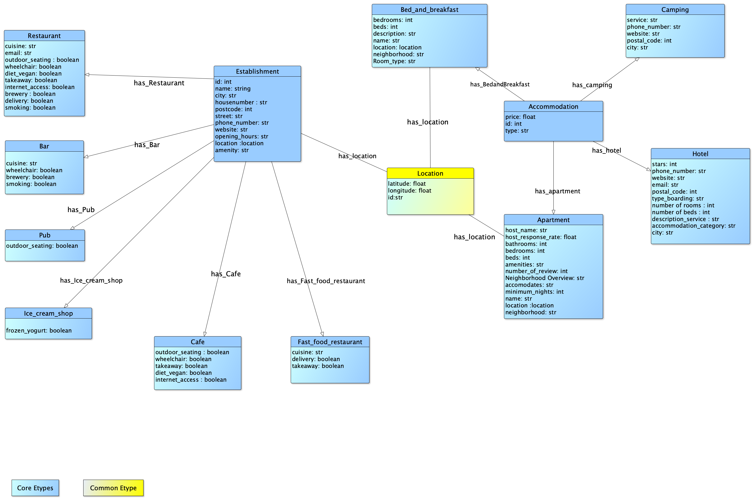
Informal Model
Common, core, contextual kernel concepts defined at e-type level
ER Model is formed using yED tool
Establishment and Accommodation as main e-types
Location defined as common e-type

Slide 8

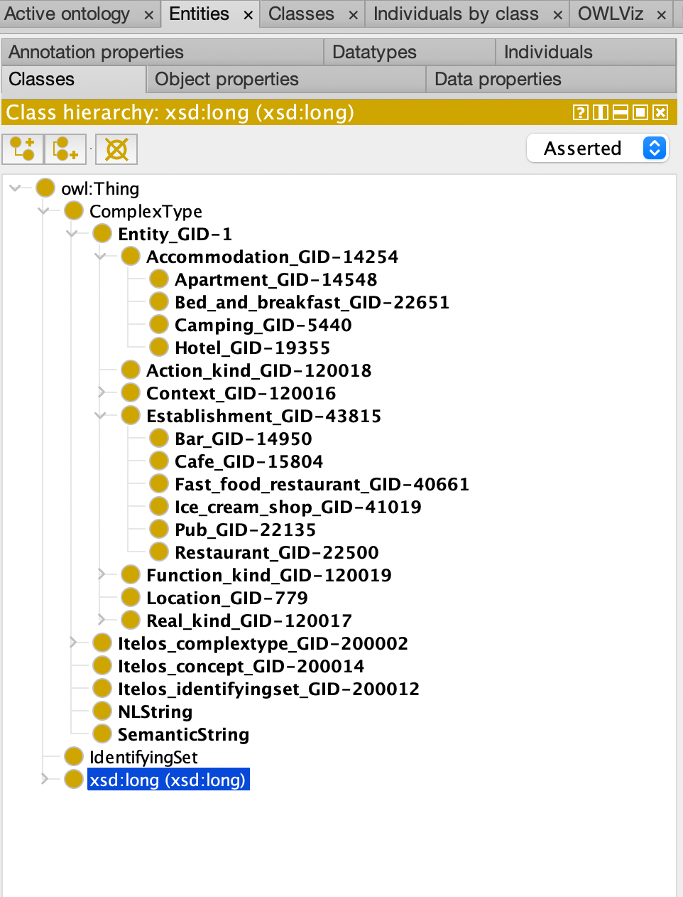
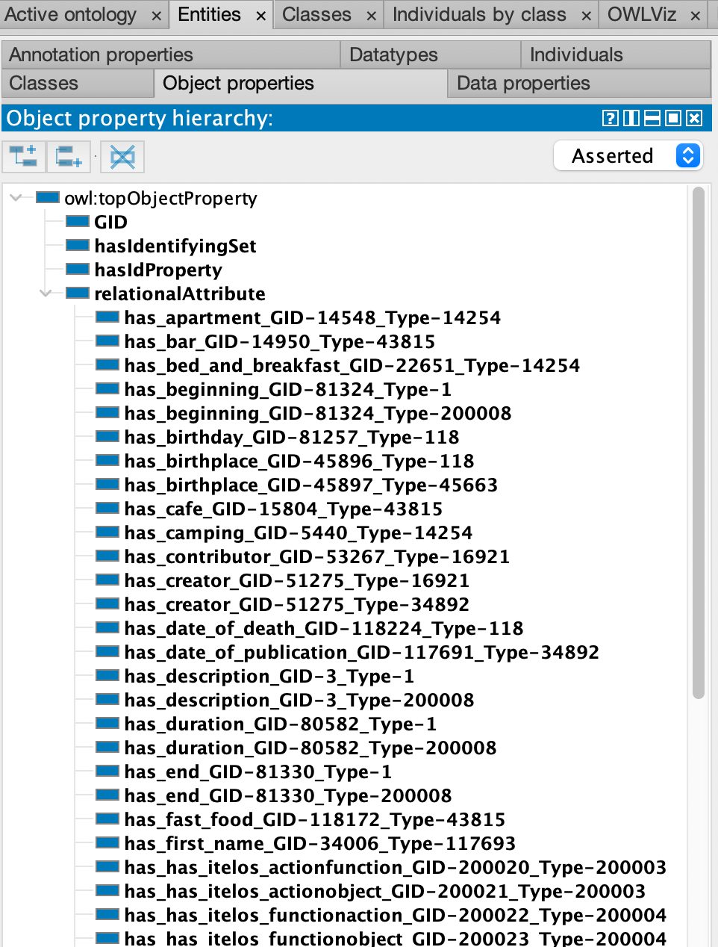
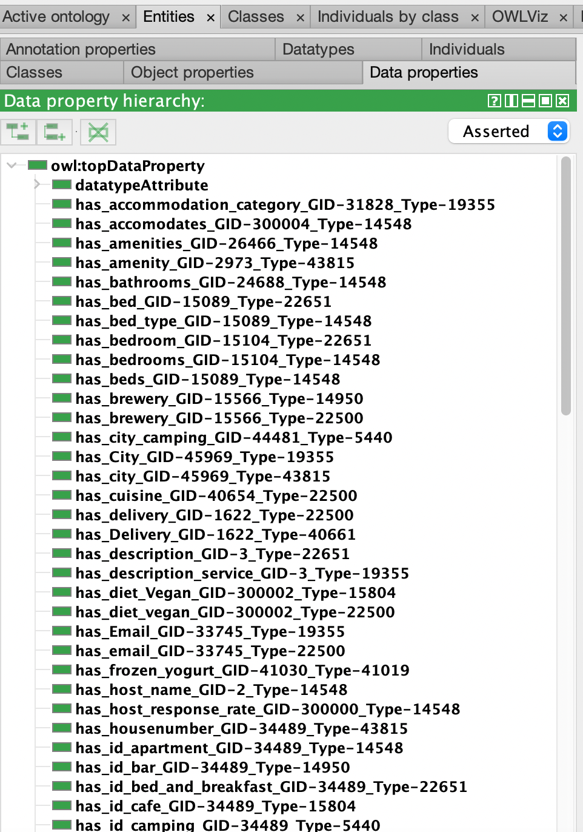
Formal modeling
ETG model
Classes
Object properties
Data properties

Slide 9
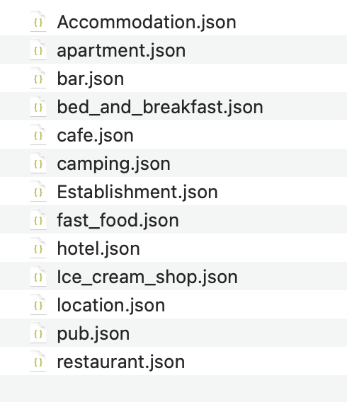
Data management
Clear data
Translate Italian to English
Convert json file

Slide 10
Evaluation
 | Inception | Informal Modeling | Formal Modeling
E-type coverage | 0.9 | 1 | 0.92
Property coverage | 0.62 | 0.98 | 0.57
E-type extensiveness | 0.5 | 0.16 | 0.45
Property extensiveness | 0.74 | 0.34 | 0.62
E-type sparsity |  |  | 0.5
Property sparsity |  |  | 0.85
Schema level
Data level
 | Inception | Informal Modeling
E-type coverage | 0.9 | 0.3
Property coverage | 0.98 | 0.3
E-type sparsity | 0.64 | 0.67
Property sparsity | 0.76 | 0.65

Slide 11
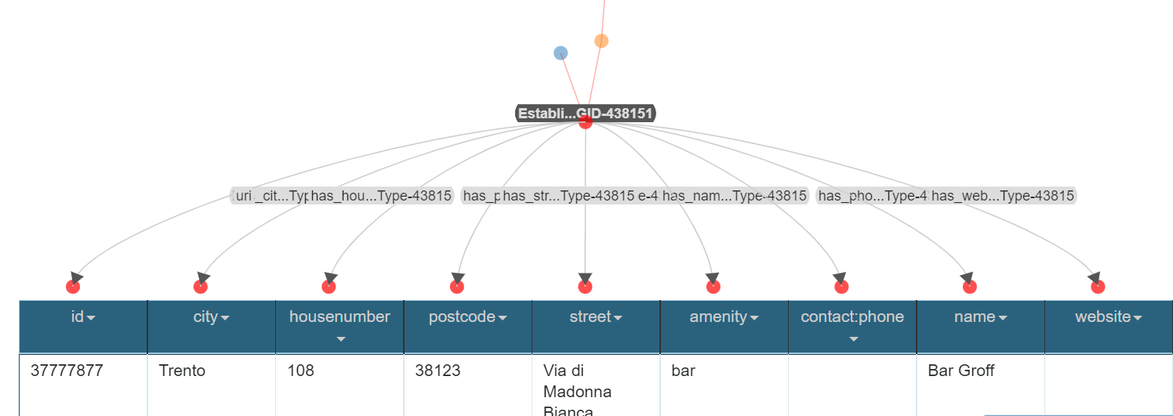
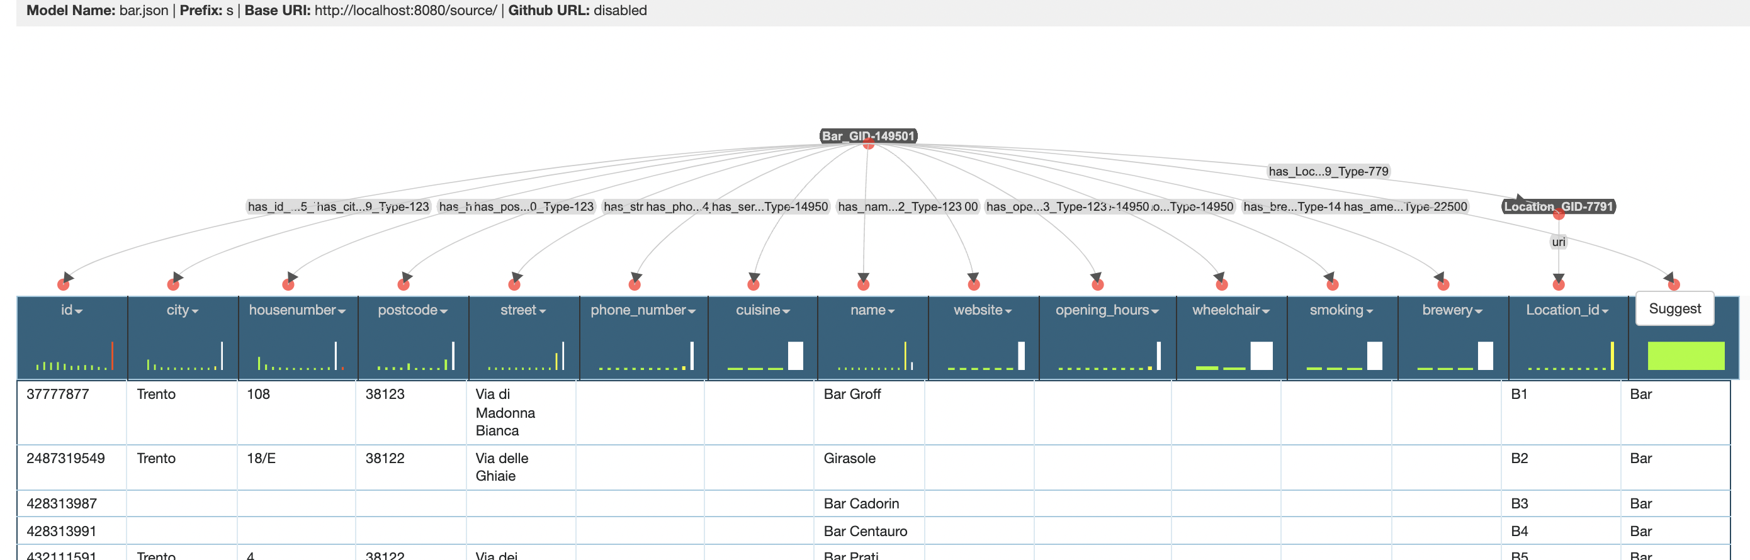
Data integration ~ KARMALINKER
Karmalinker allows us to well match the Datasets to the defined Ontology.
The final step to create the Knowledge Graph of Food and Accommodation

Slide 12

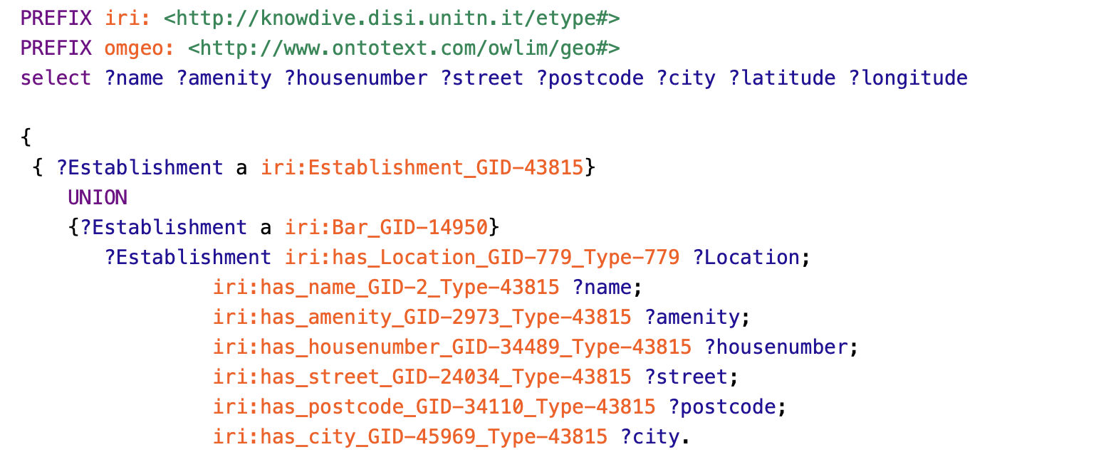
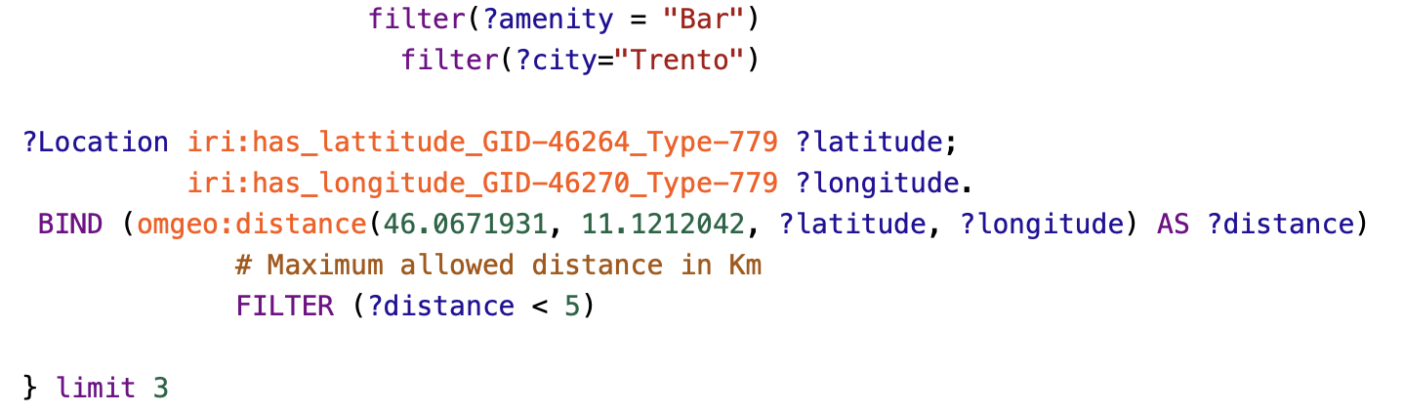
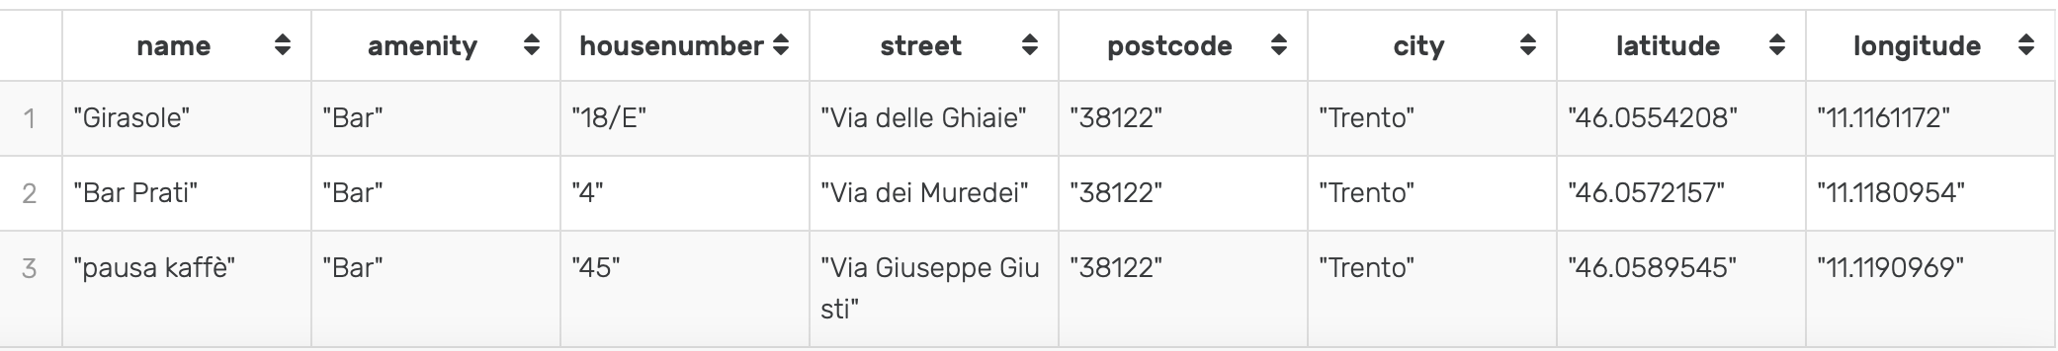
SPARQL QUERY 1
Give the list of bars near the city center in Trento?
Return list of bars with information's within 5 km from city center.

Slide 13
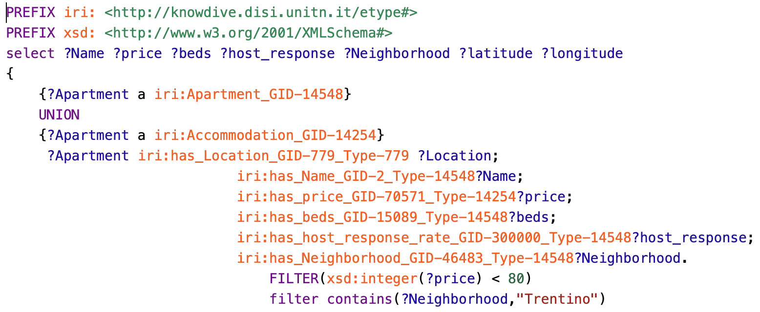
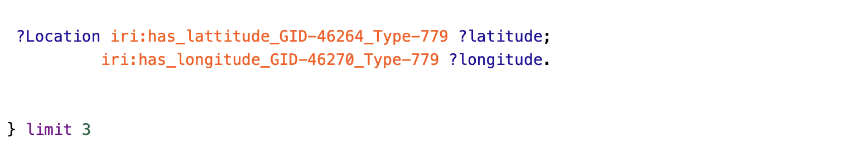
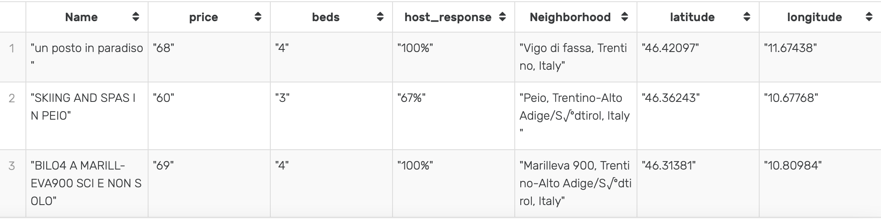
SPARQL QUERY 2
Give the list of apartment under the 80$ in Trentino?
Return list of apartments with data properties in Trentino.

Slide 14
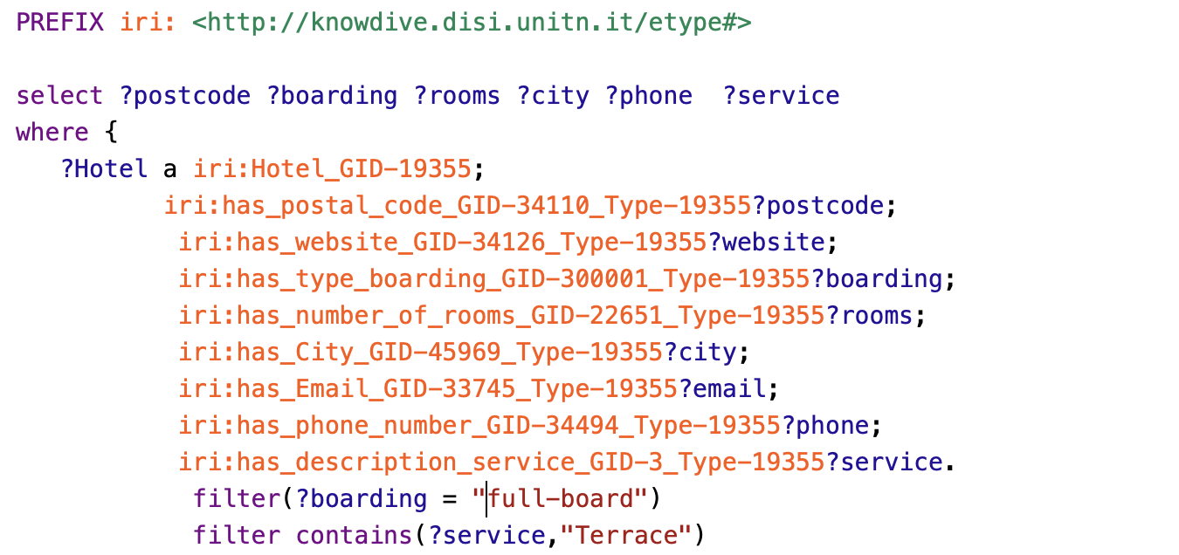
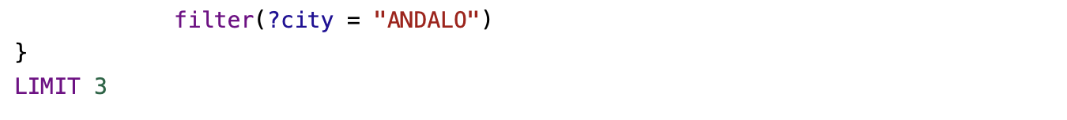
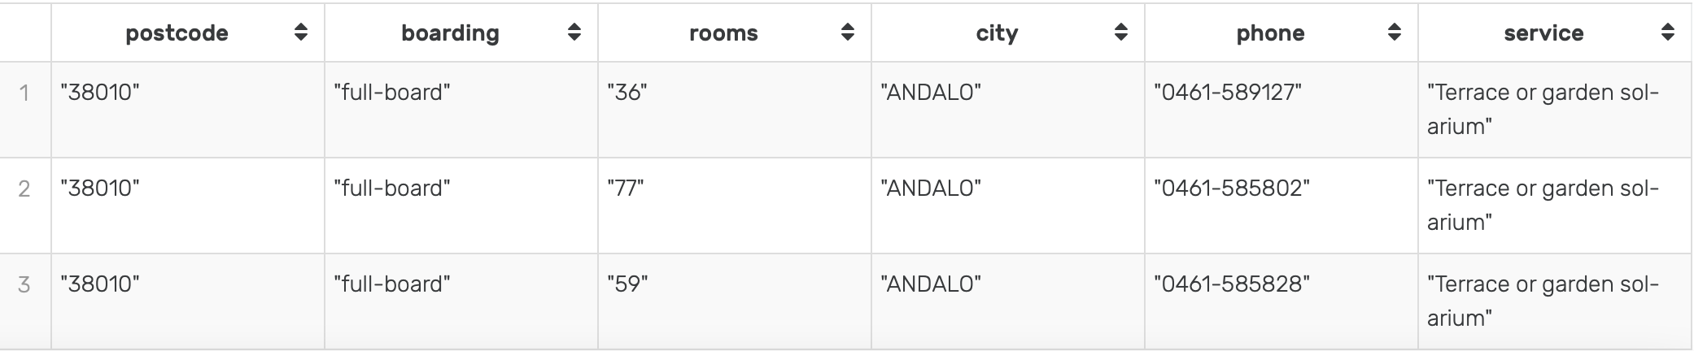
SPARQL query 3
Give the list of hotels with full-board and terrace in Andalo?
Return list of hotels with data properties in Andalo.

Slide 15
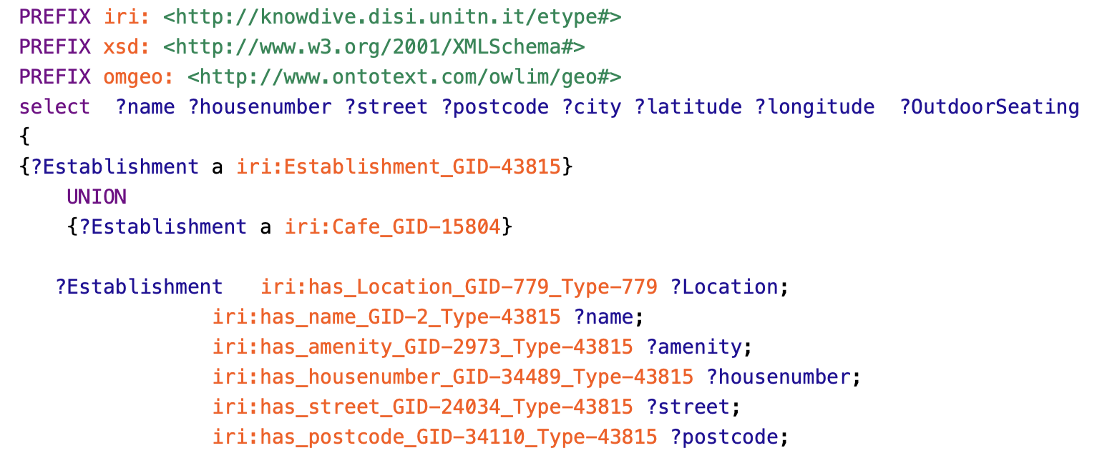
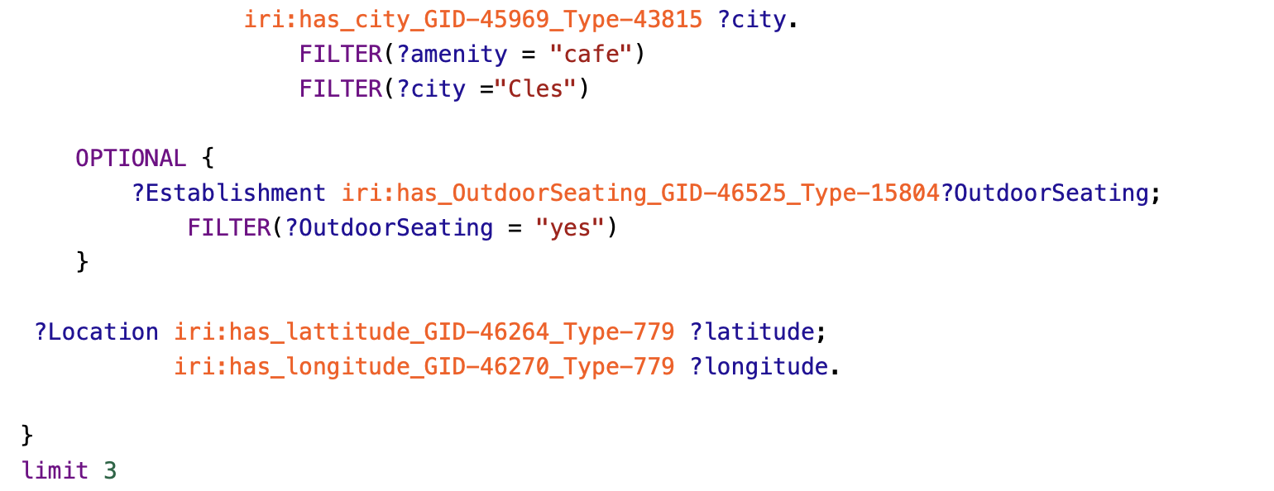
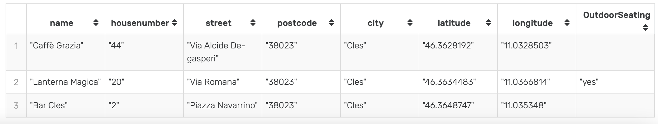
SPARQL query 4
Give the list of café with outdoor seating in Cles?
Return list of café with information's.

Slide 16
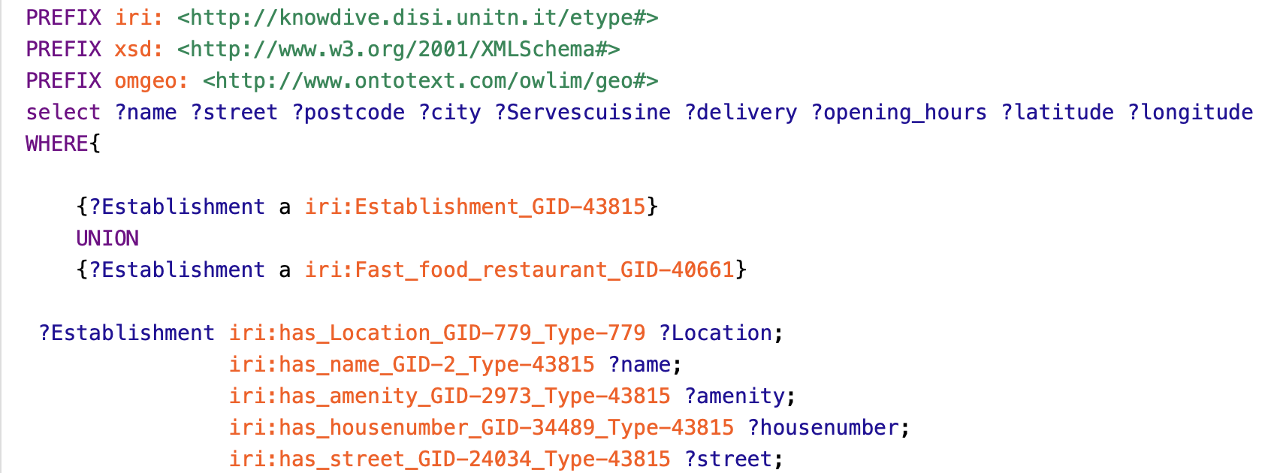
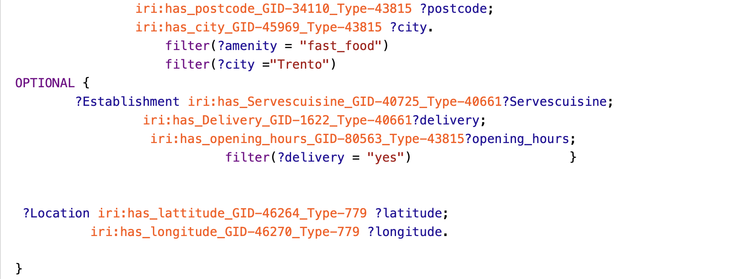
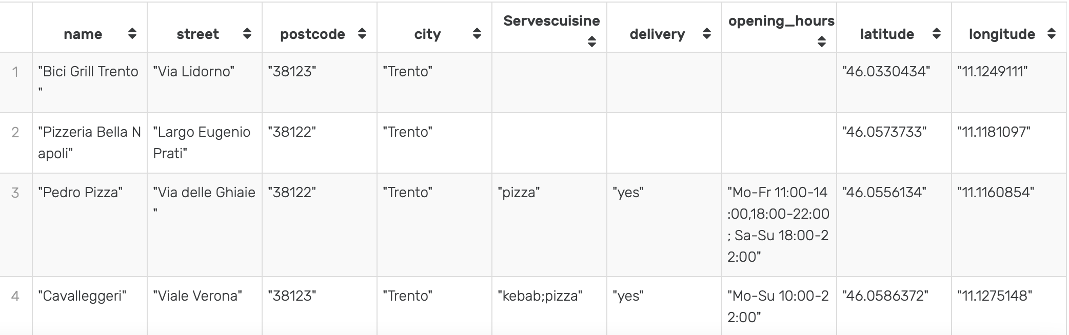
SPARQL query 5
Give the list of fast-food restaurant with delivery in Trento?
Return list of fast food restaurant with data properties in Trento.

Slide 17
Thank you for lıstenıng

Slide 18
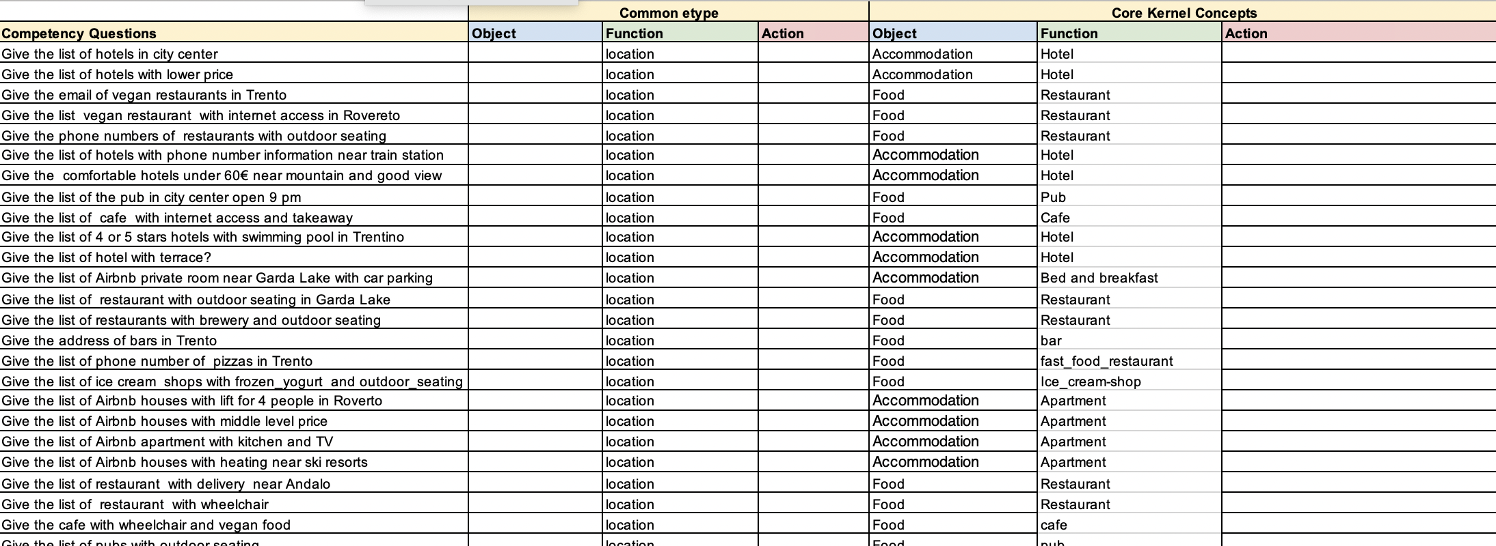
Modeling sheet

Slide 19
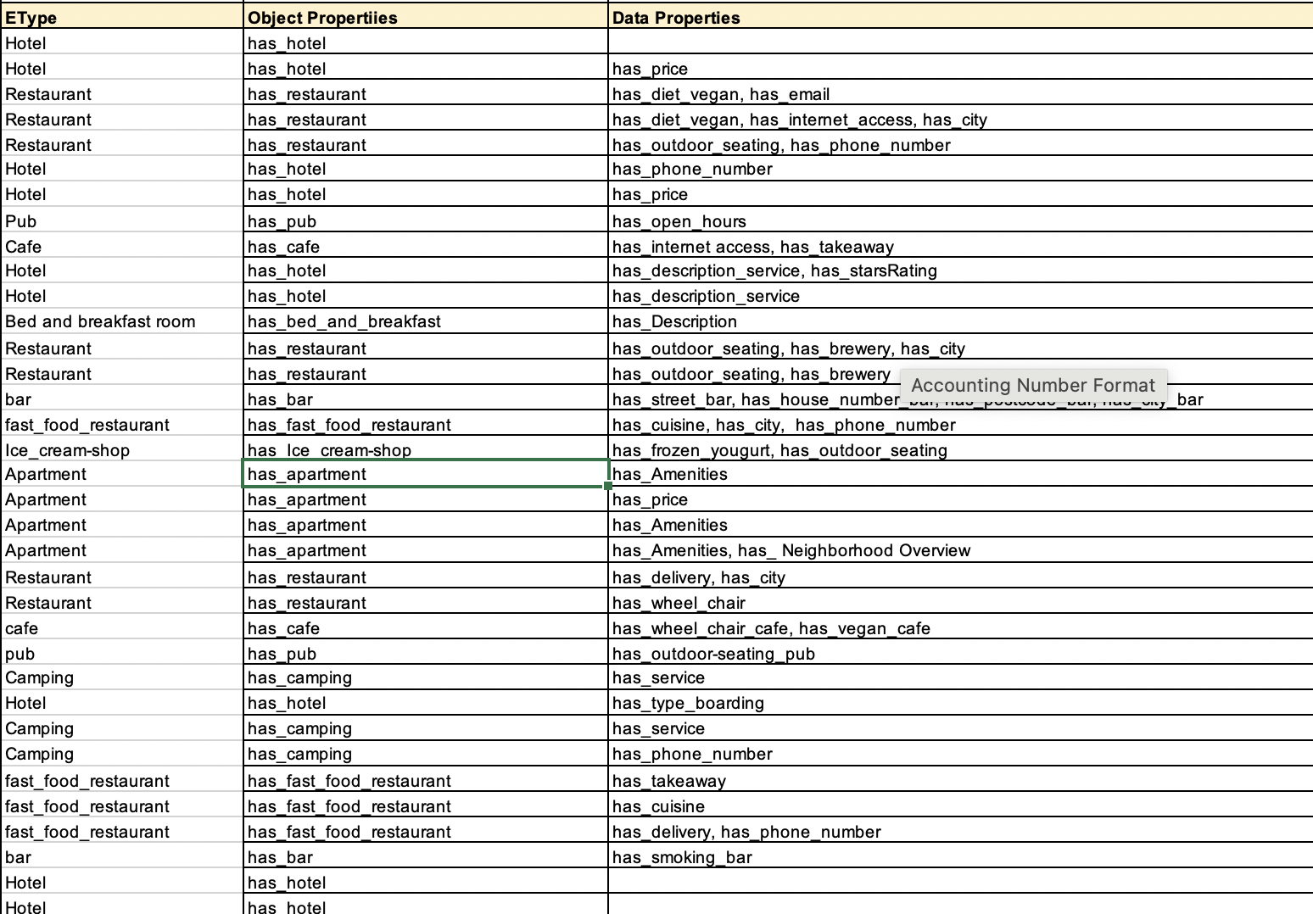
Attributed CQ_{s}
11 classes, 50 data properties
, 13 object properties

